Slide 1
3 Schema architecture
and
database users

Slide 2
Instances & Schemas
Instances
Collection of information stored in the DB at a particular moment
Instances are changed frequently (insertion & deletion)

Slide 3
Schema
Overall design of the DB
schemas are changed infrequently
Schemas partitioned according to the levels of abstraction
Physical schema: database design at the physical level
Logical schema: database design at the logical level

Slide 4


Data Independence
Achieved through the use of 3 levels of abstraction
The ability to modify a schema definition in one level without affecting a schema definition in higher level is called data independence
mainly two kinds of database independence
Logical data independence
Physical data independence

Slide 5
Logical data independence
The ability to change logical schema without changing external schema or application program is called logical data independence
Ex:
faculty(fid: string , fname: string , office : integer , sal: real)
Divided into
fac_public (fid: string , fname: string , office : integer) fac_private(fid: string, sal: real)
but the user who query will get the same result.

Slide 6


Physical data independence
The ability to change physical schema without changing logical schema is called Physical data independence
Changes in physical schema may include
Using new storage device
Using different data structure
Switching from one access method to another
using different storage structures
modifying indexes etc.

Slide 7
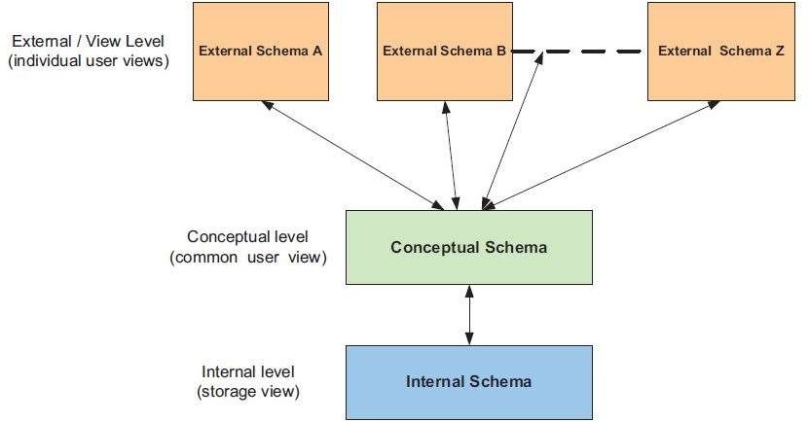
Three Schema Architecture

Slide 8
Three Schema Architecture (Cont…)
3 Level Architecture
Most modern DBMS are based on this system
Objectives
Allows independent customized user views
Hides physical storage details from users
Administrator can able to change DB storage structure without affecting User’s view
Internal structure of DB is unaffected by the changes to the physical aspects of storage
Admin can able to change the conceptual structure of DB without affecting users

Slide 9
Three Schema Architecture (Cont…)
A) External / View level
Many users are not concerned with all the information in database(access only portion of DB)
Simplifies the end user’s interaction with the system
System may produce many views for the same database

Slide 10
Conceptual / Logical level
Describes about the data stored in the database & relationship among the stored data
This level is used by the DBA
DBA decide what information kept in database
Internal / Physical level
Lowest level of abstraction
Describes data storage and access methods
DBA may aware of certain details of the physical organization of data
Describes how the data are actually stored

Slide 11
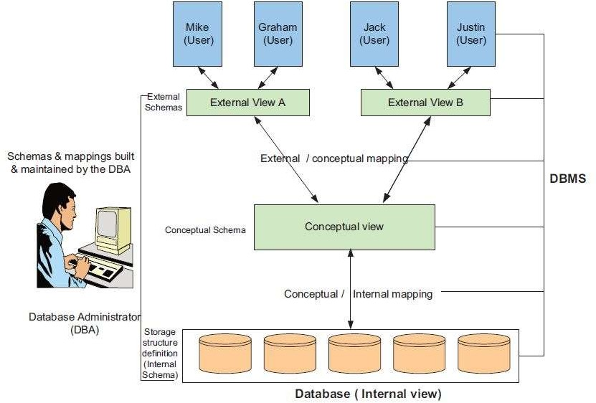
Detailed Three Schema Architecture
(Cont…)

Slide 12
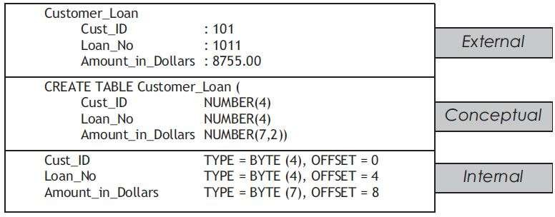
Three Schema Architecture (Cont…)

Slide 13
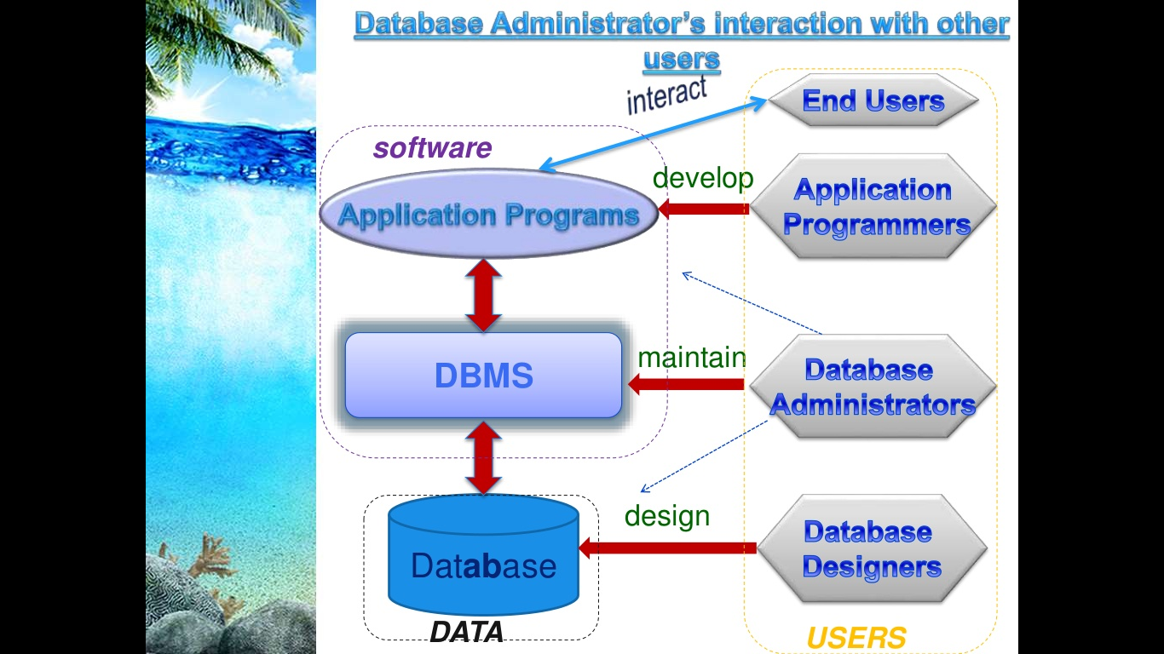

Slide 14




ACTORS ON THE SCENE
Database Administrator
In a database environment, the primary resource is the database itself, and administering these resources is the responsibility of the database administrator (DBA). The DBA is responsible for authorizing access to the database, for coordinating and monitoring its use, and for acquiring software and hardware resources as needed.

Slide 15
Database Designer
Database designers are responsible for identifying the data to be stored in the database and for choosing appropriate structures to represent and store this data. It is the responsibility of database designers to communicate with all prospective database users in order to understand their requirements, and to come up with a design that meets these requirements.

Slide 16
End Users
End users are the people whose jobs require access to the database for querying, updating, and generating reports; the database primarily exists for their use. There are several categories of end users:
Casual end users occasionally access the database, but
they may need different information each time.
Naive or parametric end users -Their main job function revolves around constantly querying and updating the database, using standard types of queries and updates-called canned transactions.

Slide 17
End Users
Sophisticated end users include engineers, scientists, business analysts, and others who thoroughly familiarize themselves with the facilities of the DBMS so as to implement their applications to meet their complex requirements.
Stand-alone users maintain personal databases by using ready-made program packages that provide easy- to-use menu-based or graphics-based interfaces.

Slide 18
System Analysts and Application Programmers (Software Engineers)
System analysts determine the requirements of end users, especially naive and parametric end users, and develop specifications for canned transactions that meet these requirements. Application programmers implement these specifications as programs.

Slide 19

WORKERS BEHIND THE SCENE
DBMS system designers and implementers are persons who design and implement the DBMS modules and interfaces as a software package.
Tool developers include persons who design and implement tools-the software packages that facilitate database system design and use and that help improve performance.
Operators and maintenance personnel are the system administration personnel who are responsible for the actual running and maintenance of the hardware and software environment for the database system.

